Slide 1



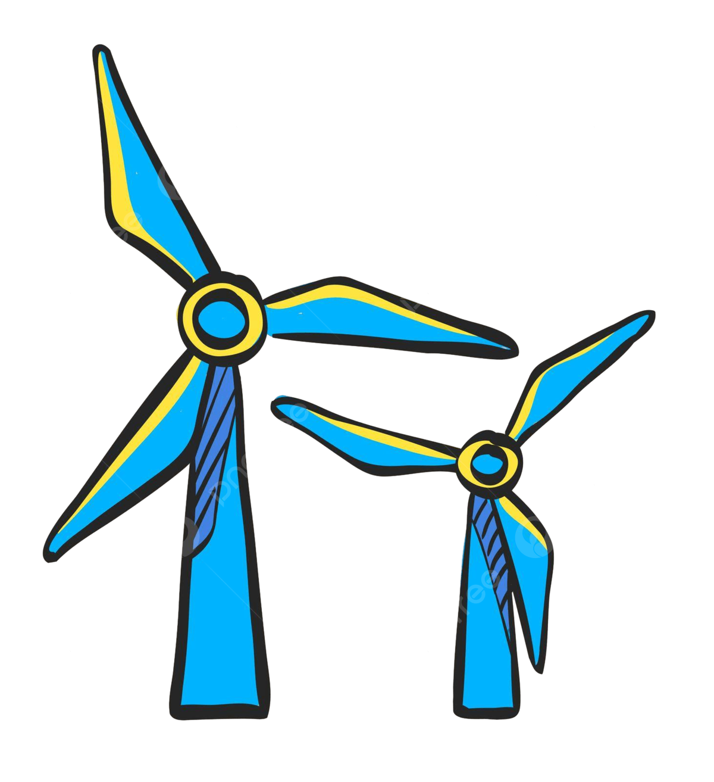
Weekly report: Optimus Syria - WEC Development Project
Machine Bed & Yaw System
Date: 10/09/2025
Supervisor: Prof. Quell Peter
Group members: Shoukat Abbas, Luksh Chawla, Sathishkumar Venkatachalam, Shrihari Kadam
Flensburg University of Applied Sciences

Slide 2

Objectives
Machine Bed:
Variants
Interfaces
Design & Calculations
Yaw System:
Variants
Specification & Calculations
Control and wear considerations
Shared Tasks:
Supplier base analysis
Benchmarking and concept definition

Slide 3

Week 1: Kickoff & Setup
Tasks:
Studied kickoff slides (team role, deliverables).
Downloaded software (Solidworks, Ansys, Matlab)
Obtained last years documentation.
Reviewed IEC 61400 & DNV standards for nacelle/yaw.
Outcome:
Clear definition of scope.
Set up file-sharing (GitHub, documentation).

Slide 4

Week 2: Literature Review
Tasks:
Reviewed papers on designing. (Design, Analysis, and Development of a nacelle main load frame for a 500KW wind turbine.) [1].
On yaw systems, Artificial Neural Network Based Reinforcement Learning for Wind Turbine Yaw Control. [2].
Studied state-of-the-art hydraulic yaw systems for wind turbines. [3].
Research papers for a better understanding of nacelle tower foundation, Optimization of the Yaw Control Error of Wind Turbine. [5] [6].

Slide 5
Week 2: Literature Review Continue
Collected references on machine bed concepts.
Compared cast vs welded bedplates.
Outcome:
Selected casted bedplate as likely concept for Syria (Stiffness + damping).
Noted yaw optimization methods.

Slide 6
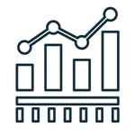
Week 3: Concept Benchmarking
Tasks:
Reviewed yaw system concepts and design methods. [4]
Studied suppliers for yaw bearings & drives.
Drafted comparison table (electric vs hydraulic yaw drives).
Outcome:
Direction: Electrical Yaw Drives
Casted bedplate confirmed as baseline.

Slide 7

Week 4: Context Research
Tasks:
Analyzed Syrian context: hot/dusty climate from Github (details provided of each zone), weak grids, transport issues.
Connected with Loads & Dynamics team for expected load transfer.
Checked with Wind Speed to Height (Peak wind speed Max. and Min. throughout the year. (From Github)
Outcome:
Constraints point to casted bedplate, high-temp lubrication, robust yaw brakes.
Next: continue detailed research before starting CAD modelling later.

Slide 8

Challenges & Next Steps
Need load cases from the Loads & Dynamics team.
Got a data table.
Next tasks:
Wait for load case definitions (from the Loads team).
Continue literature & supplier research.
Prepare simple comparison tables for the report.

Slide 9
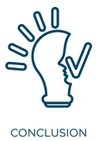
Conclusion
First 4 weeks:
We are on track for gradual progress.
Detailed design (CAD/FEM) will start sooner in the semester.
Setup
1
Literature Review
2
Concept Benchmarking
3
Context Research
4

Slide 10
References
[1]Pehlivan, Selim Ahmet, “Desing analysis and development of a nacelle main load frame for a 500 kW wind turbine - Sabanci University Research Database,” Sabanciuniv.edu, 2016, doi: https://research.sabanciuniv.edu/id/eprint/29129/1/AhmetSelimPehlivan_442646.pdf.
[2]A. Saenz-Aguirre, E. Zulueta, U. Fernandez-Gamiz, J. Lozano, and J. Lopez-Guede, “Artificial Neural Network Based Reinforcement Learning for Wind Turbine Yaw Control,” Energies, vol. 12, no. 3, p. 436, Jan. 2019, doi: https://doi.org/10.3390/en12030436.
[3]Søren Stubkier, H. C. Pedersen, T. O. Andersen, and K. Markussen, “State of the art-hydraulic yaw systems for wind turbines,” Proc. 12th Scandinavian International Conference on Fluid Power, Jan. 2011, Available: https://www.researchgate.net/publication/262003240_State_of_the_art-hydraulic_yaw_systems_for_wind_turbines
[4]M-G. Kim and P. H. Dalhoff, “Yaw Systems for wind turbines – Overview of concepts, current challenges and design methods,” Journal of Physics: Conference Series, vol. 524, p. 012086, Jun. 2014, doi: https://doi.org/10.1088/1742-6596/524/1/012086.
[5]S. Wang, Y. Huang, L. Li, C. Liu, and D. Zhang, “Dynamic analysis of wind turbines including nacelle–tower–foundation interaction for condition of incomplete structural parameters,” Advances in Mechanical Engineering, vol. 9, no. 3, p. 168781401769294-168781401769294, Mar. 2017, doi: https://doi.org/10.1177/1687814017692940.
[6]Y. Liu, S. Liu, L. Zhang, F. Cao, and L. Wang, “Optimization of the Yaw Control Error of Wind Turbine,” Frontiers in Energy Research, vol. 9, no. 6, Feb. 2021, doi: https://doi.org/10.3389/fenrg.2021.626681.

